Slide 1
Decision Tree
Dr. Muhammad Safyan

Slide 2
Day | Weather | Temperature | Humidity | Wind | Play?
D1 | Sunny | Hot | High | Weak | No
D2 | Sunny | Hot | High | Strong | No
D3 | Overcast | Hot | High | Weak | Yes
D4 | Rain | Mild | High | Weak | Yes
D5 | Rain | Cool | Normal | Weak | Yes
D6 | Rain | Cool | Normal | Strong | No
D7 | Overcast | Cool | Normal | Strong | Yes
D8 | Sunny | Mild | High | Weak | No
D9 | Sunny | Cool | Normal | Weak | Yes
D10 | Rain | Mild | Normal | Weak | Yes
D11 | Sunny | Mild | Normal | Strong | Yes
D12 | Overcast | Mild | High | Strong | Yes
D13 | Overcast | Hot | Normal | Weak | Yes
D14 | Rain | Mild | High | Strong | No

Slide 3
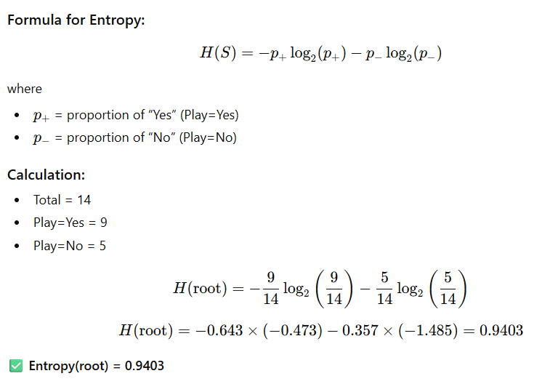
Step 0 — Root Node

Slide 4
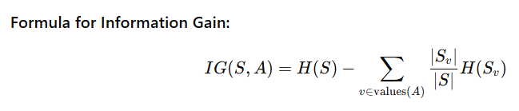
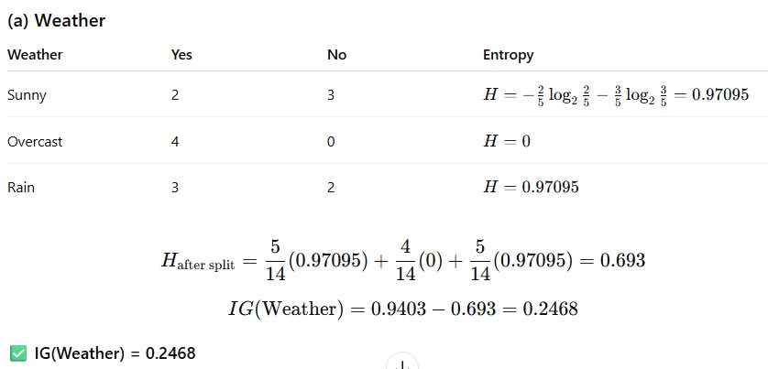
Step 1 — Information Gain for Each Attribute

Slide 5
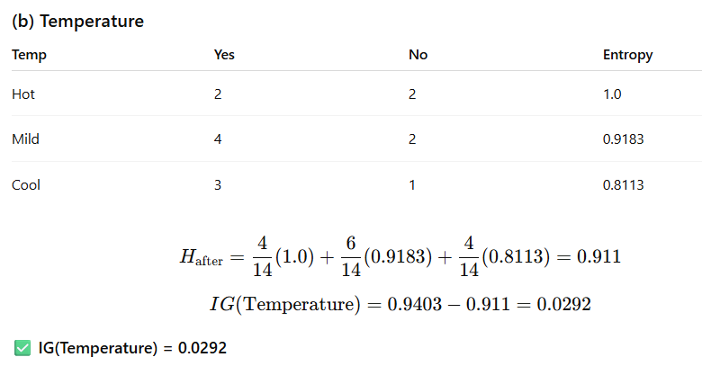
Step 1 — Information Gain for Each Attribute

Slide 6
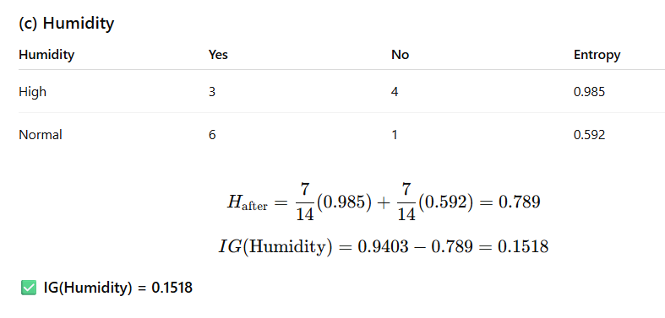
Step 1 — Information Gain for Each Attribute

Slide 7
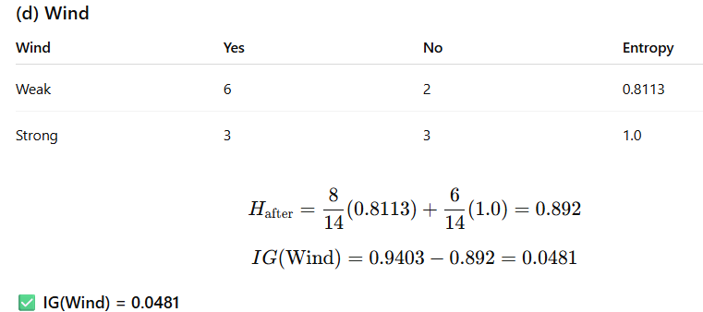
Step 1 — Information Gain for Each Attribute

Slide 8
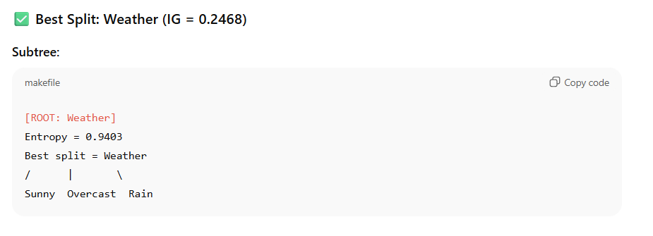
Step 1 — Information Gain for Each Attribute

Slide 9
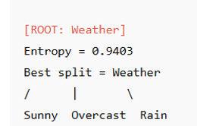
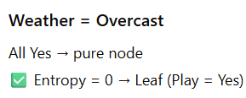
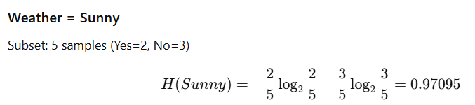
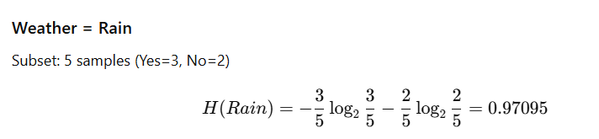
Step 2 — Expand Weather Branches

Slide 10
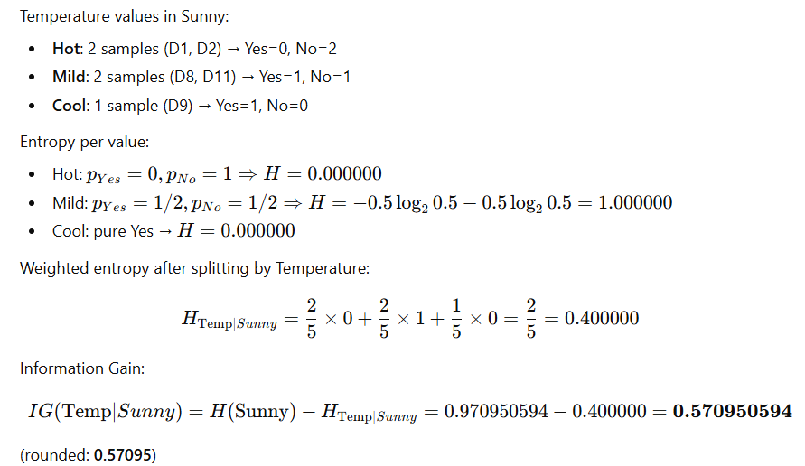
Temperature (within Sunny)

Slide 11
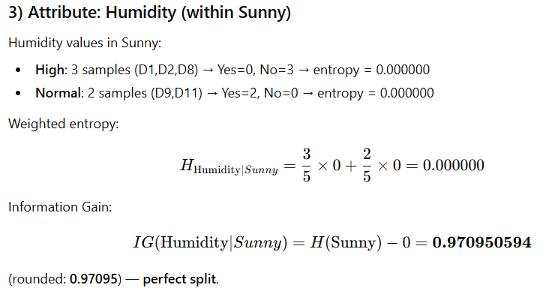
Attribute: Humidity (within Sunny)

Slide 12
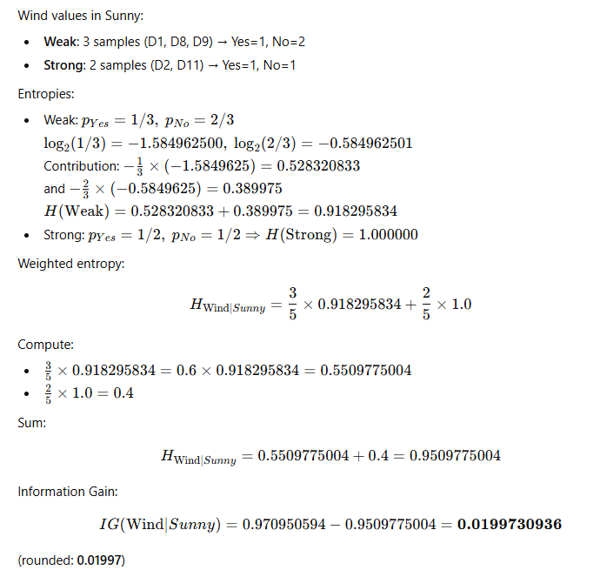
Attribute: Wind (within Sunny)

Slide 13
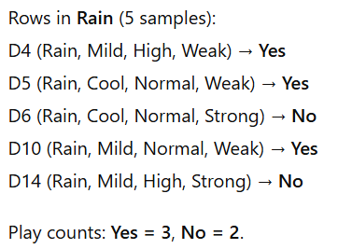
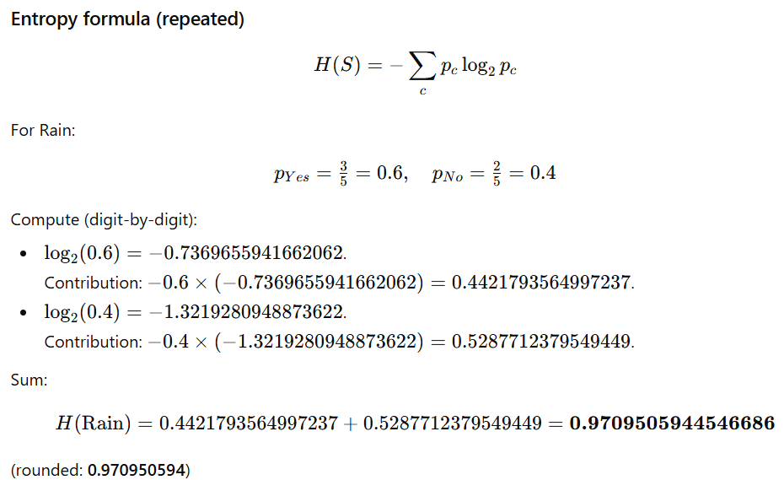
Weather = Rain

Slide 14
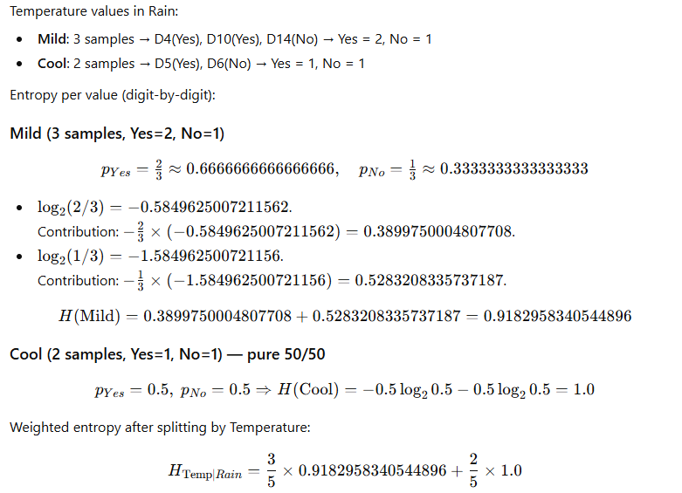
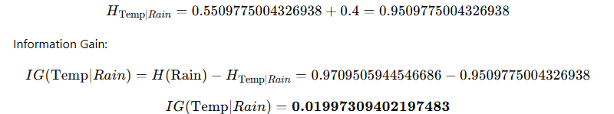
Attribute: Temperature (within Rain)

Slide 15
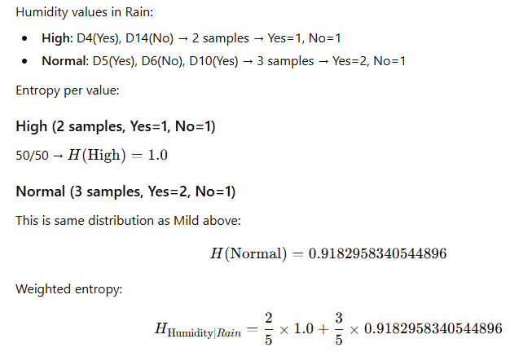
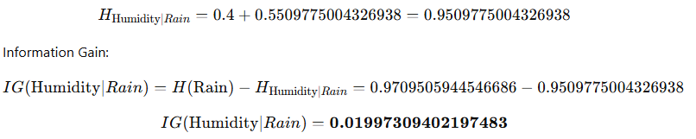
Attribute: Humidity (within Rain)

Slide 16
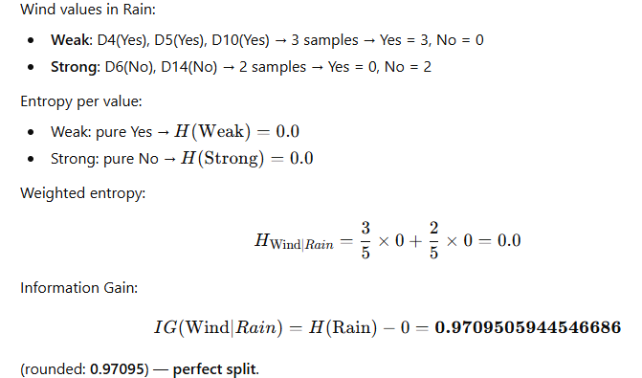
Attribute: Wind (within Rain)

Slide 17
